Slide 2
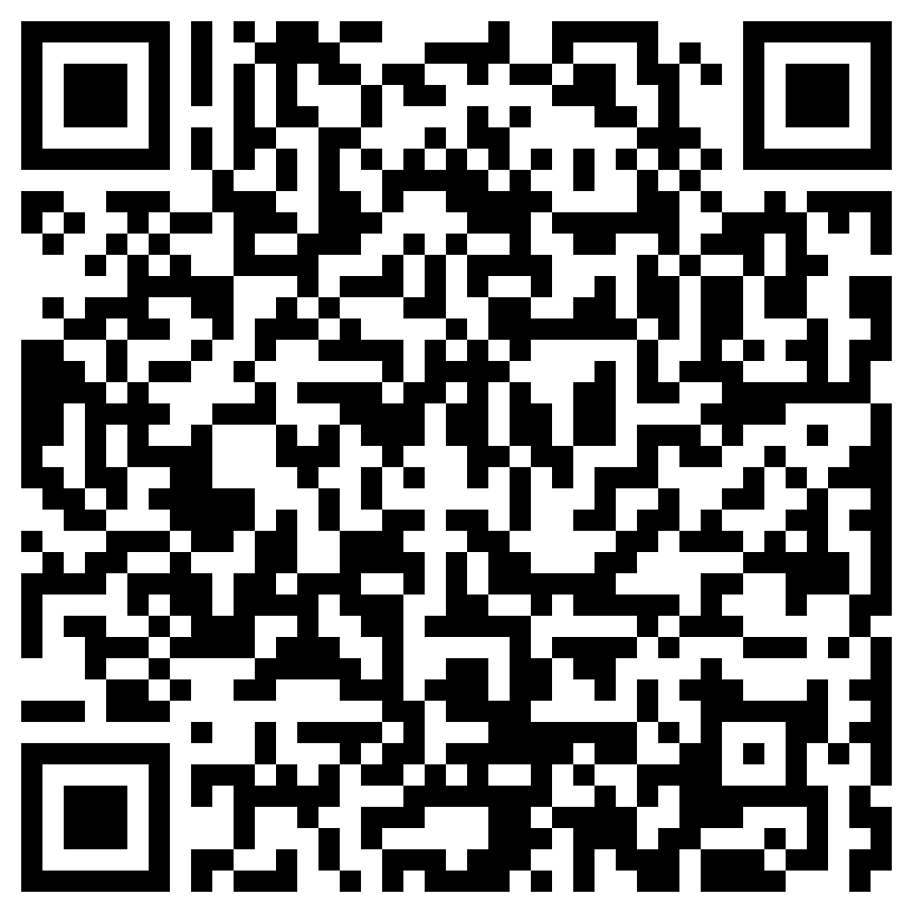
Scan here to donate

Slide 3
Scan here to donate

